Slide 1

Rapid “Cross” Platform DSP with the ARM Cortex M4/M7
Eli Hughes
ehughes@wavenumber.net

Slide 2
Presentation Scope
In the “trenches” perspective.
DSP Evolution, history and application rationale
Quick introduction to the Cortex M4 & M7
Vendors & tool-chains
Look at some “interesting” instructions
CMSIS-DSP library
Performance stats
Some fun demos

Slide 3
Where I got Started….
Active Pickguard
http://www.2pl-1.com/active-pickguard/

Slide 4
Digital Signal Processing
DSP is an application of discrete math to digital systems
One doesn’t necessarily need a special chip to implement a DSP algorithm
I can implement DSP on an 8051…. Or an abacus…. It just might not be as fast or as sophisticated as I would like it to be
I can also choose to implement a 2 tap FIR running at 1Hz sample rate with 4-bit data on a $5000 FPGA

Slide 5
The Evolution of DSP Hardware
Truckloads
FPGA / Logic
6σ?
Dedicated High End “DSP” Chip (ADI SPARC, TI C6000)
DSP’ometer
Dedicated “Low End” Chip (Microchip DsPIC, Freescale DSP56F)
32-BIT MCU
16-BIT MCU
8-BIT MCU
Abacus
Sun goes “supernova”
0
Time

Slide 6
The 6σ
DSP has traditionally been relegated to specialized processors and architectures.
There exists a large number of DSP applications that don’t require an expensive FPGA or high-end specialized chip.
Many applications also need the standard IO (USB, Ethernet, etc.)
The M4 can be useful for many applications. Keep in mind it is still general purpose RISC. Lots of register manipulation!

Slide 7
Applications
IIR Filter on a dynamic sensor / accelerometer
A matched filter to detect an event
Some sort of frequency domain analysis
Real time control systems, low/mid range audio….
Can’t do it with 8051…. need USB, Ethernet, etc. Maybe need moderate sample rates.

Slide 8
Application Example – “Play Node”
Consider a “box” to implement networked sounds, sensors and lighting.
Boxes are distributed over a large area (25m x 25m).
A master controller communicates with the nodes to form a cool outdoor “games space”

Slide 9
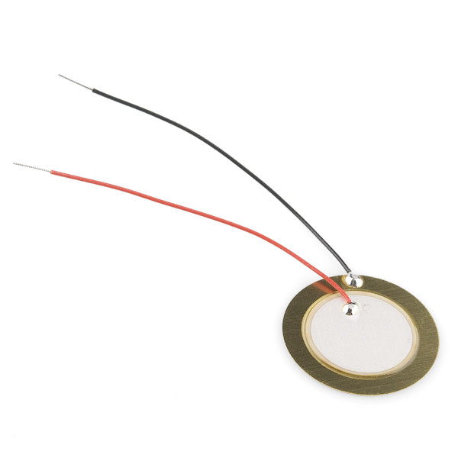
Application Example – “Play Node”
Requirement #1 - The worlds most rugged and inexpensive input device…. “The Acoustic Button” (Need 4 Channels)
Notes:
4aa

Slide 10
Application Example – “Play Node”
Requirement #2 - Sound Playback – 44.1KHz – 4 Channels .wav or .mp3
Requirement #3 - Embedded FAT File system on USB Thumb Drive…. USB Mass Storage Class Host
Requirement #4 - Lighting Control for WS2812 or APA102 “smart” LEDs. Control effects on chains of 100’s of pixels at 30FPS
Requirement #5 – CAN Bus communications

Slide 11
Application Example – “Play Node”
Requirement #6 – USB Device input - Mass storage Class to configuration file system
Requirement #7 – Misc Inputs (4-20mA)
Requirement #8 – Instant Boot & Real Time…. No Linux
Requirement #9 - Can’t burn watts of Power

Slide 12
Application Example – “Play Node”
Lots of requirements…. Some light DSP + Audio + USB + CAN + Standard I/O
Cortex M4 fits well….. (This case used the NXP LPC43x Series)

Slide 13
ARM Cortex?
Who here is familiar with ARM Cortex?
3 Families
A Applications Processors - High-end cell phone/tablet chips
R Real Time - Lock-step/real-time automotive, high-end control
M Microcontroller - Focused on lower cost 32-bit. I.E. A good reason to move from 8/16-Bit.

Slide 14
ARM Cortex?
Why does Cortex M Exist?
(My opinion) To fix the architectural problems in the ARM7TDMI
A better interrupt system, common internal elements, bit-banding, thought-out API to CPU
http://community.arm.com/docs/DOC-2607

Slide 15
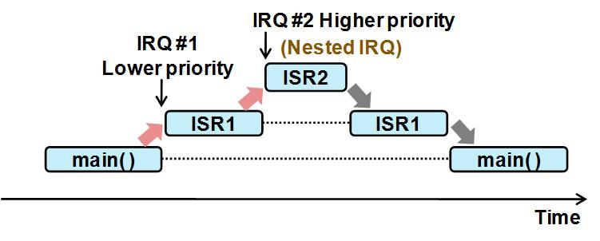
IRQ Latency and Nesting
The IRQ latency & nesting in the Cortex M allows for efficient “sample by sample processing”. Control loops, real time IIR, etc.
Input
Output
Δt

Slide 16
Cortex M – Lots of Choice
M0 --- Low End, Low Power 32-bit. 8/16-bit replacement
M3 --- Main Stream 32-bit
M4 --- M3 + DSP → What We are here for today
M7 --- More DSP under the hood through better pipline and memory architecture.
Other Variants exists but these are main stream

Slide 17
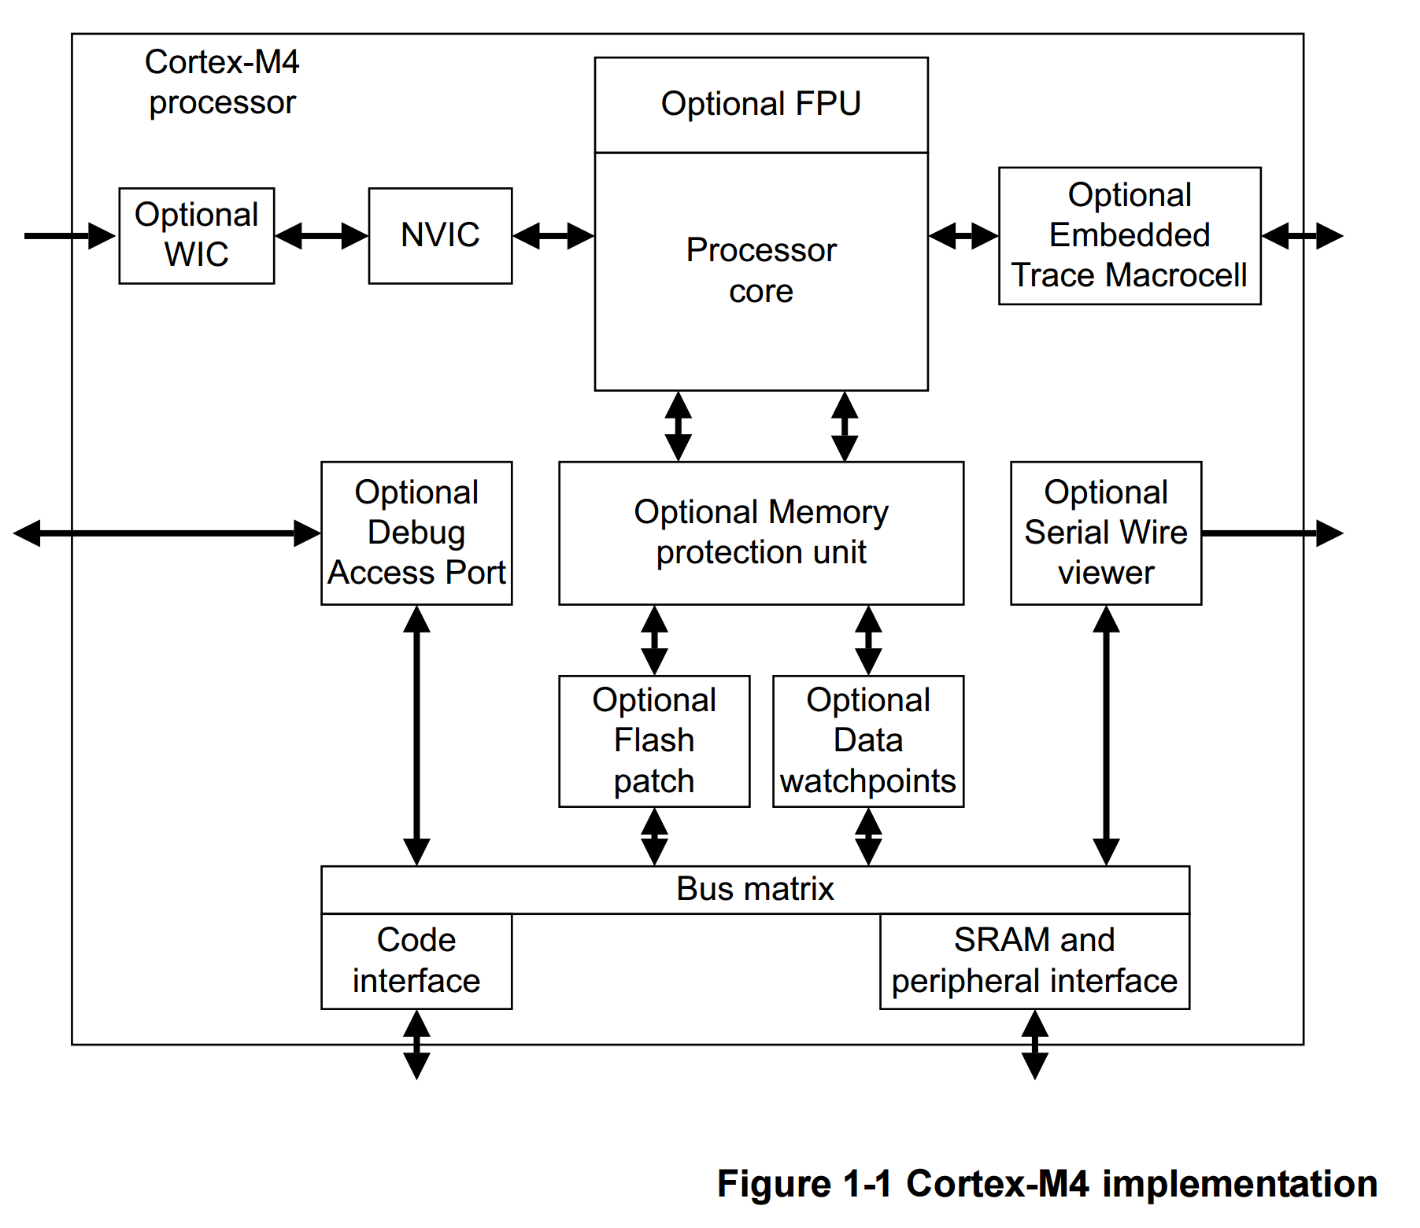
ARM Cortex M4
M3 + DSP instructions
3 Stage Pipeline
Optional 32-Bit IEEE Floating point
*some implementations have a I/D cache patched in*
http://infocenter.arm.com/help/topic/com.arm.doc.dui0553a/DUI0553A_cortex_m4_dgug.pdf

Slide 18
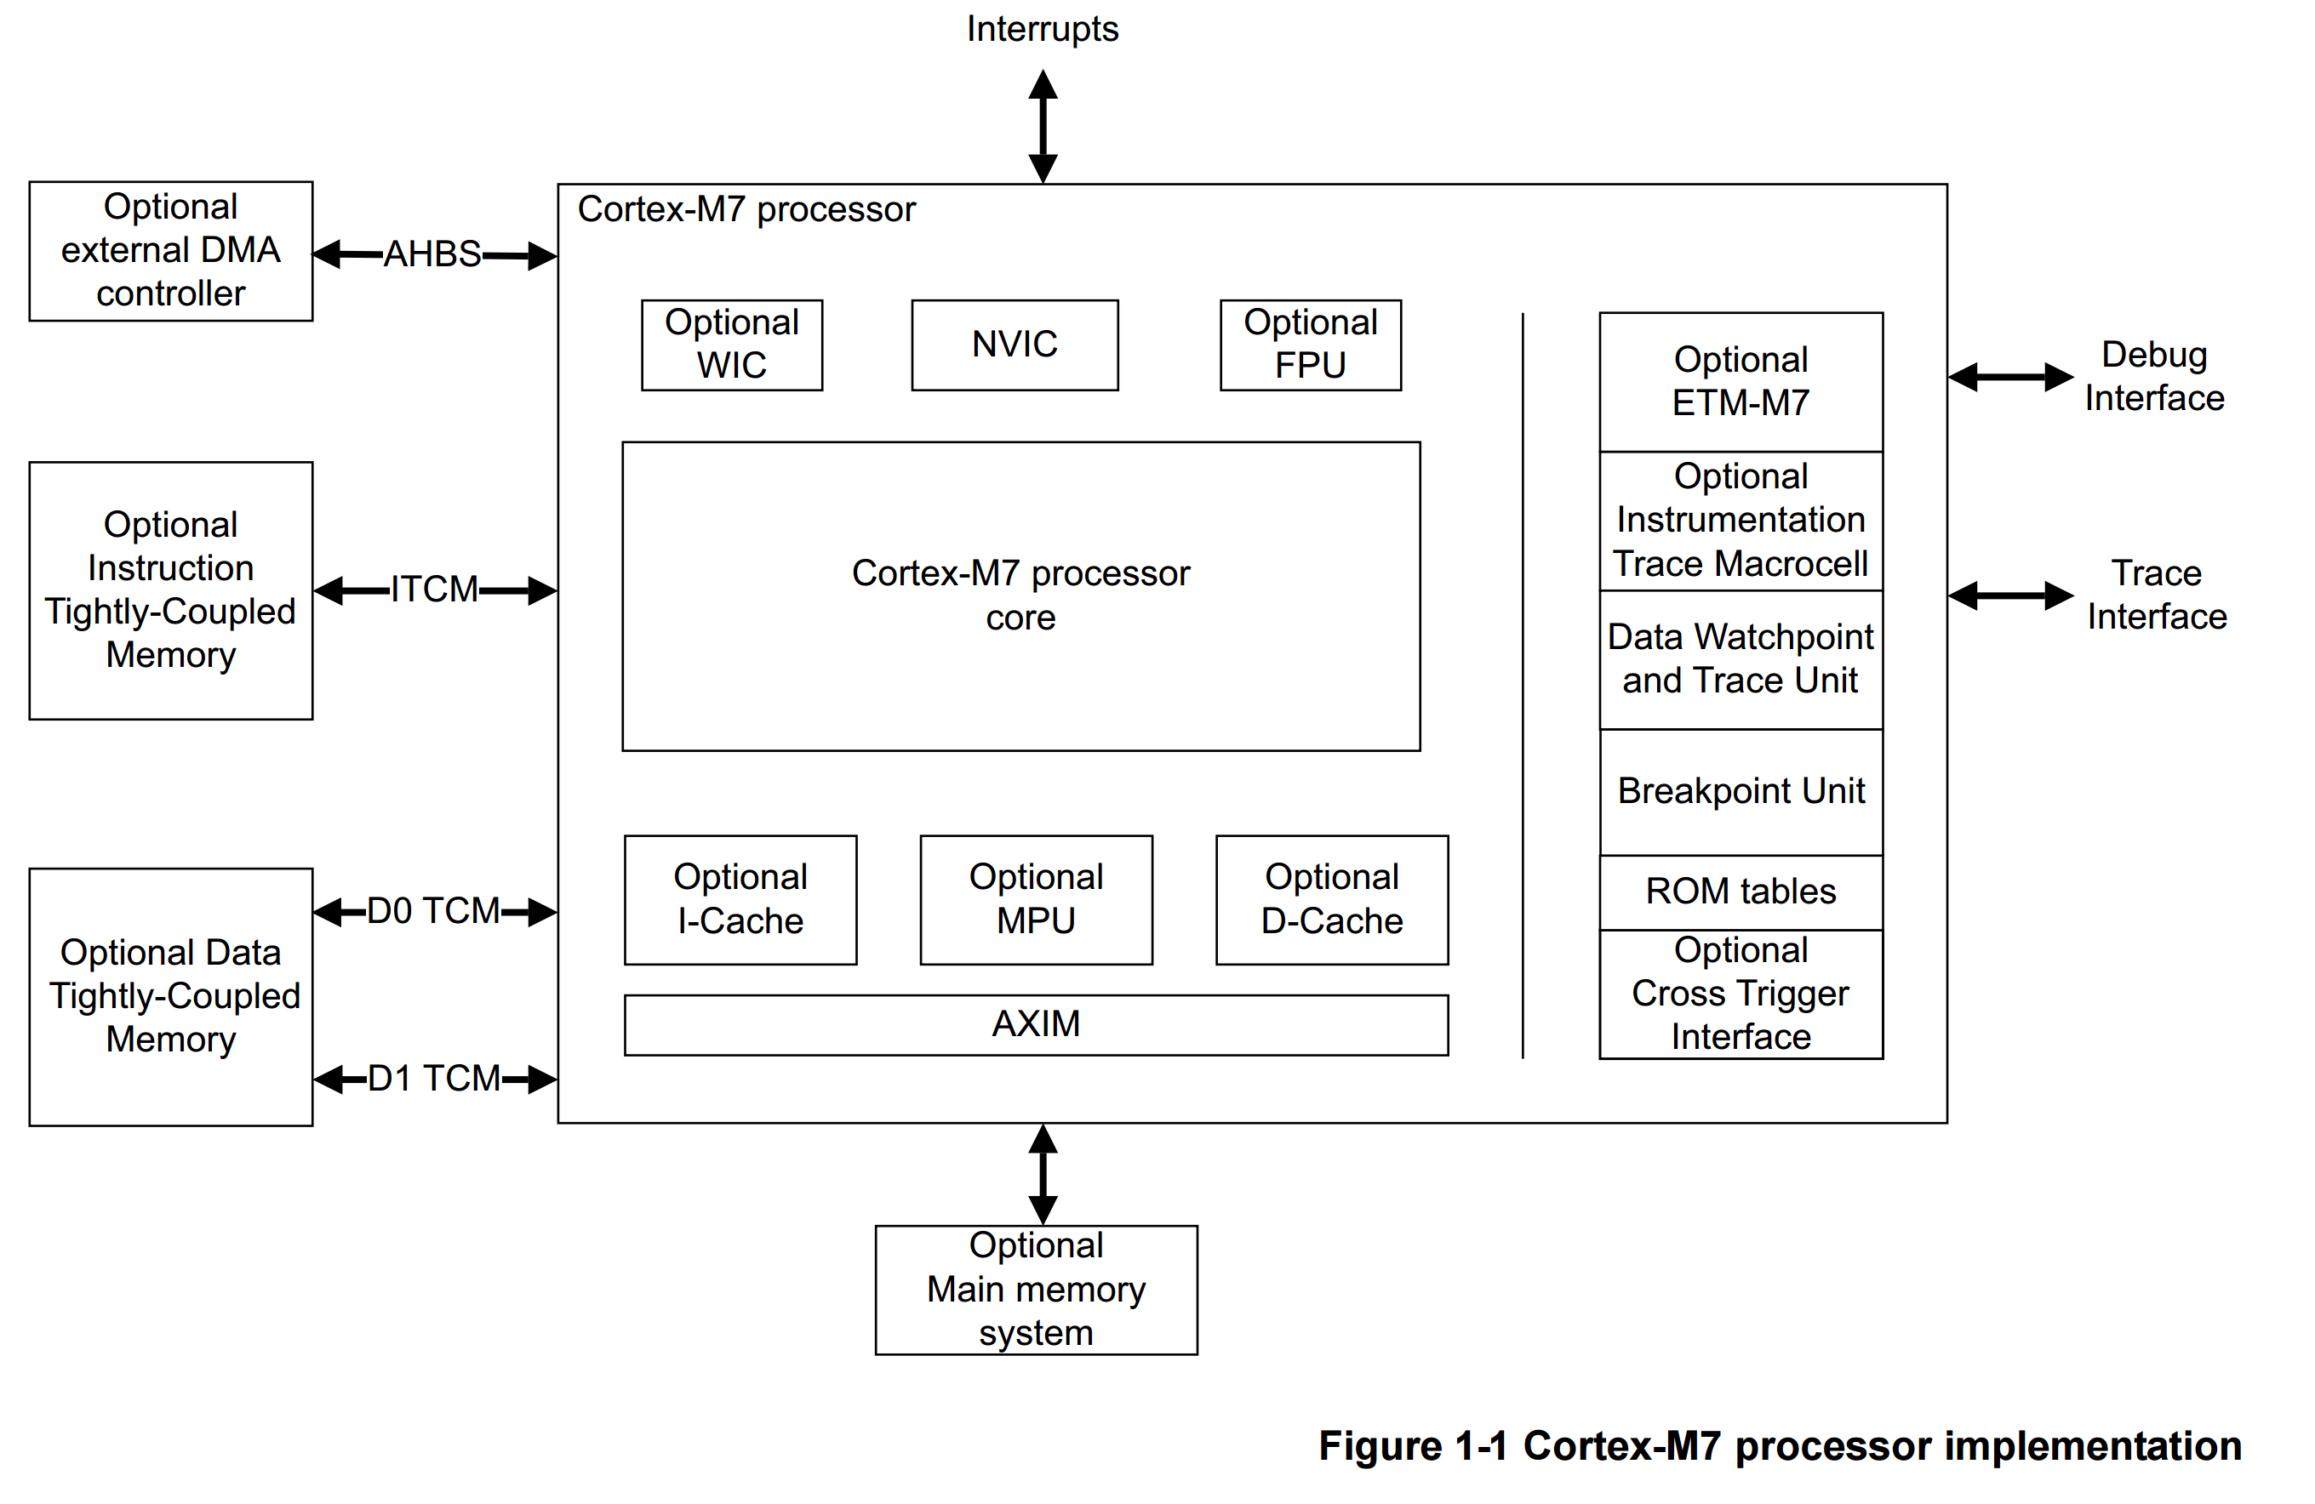
ARM Cortex M7
M4 + Better Memory Architecture & Pipeline
6 Stage Pipeline
Optional 32-Bit or 64-bit IEEE Floating point
Tightly Coupled Memory
http://infocenter.arm.com/help/topic/com.arm.doc.dui0646a/DUI0646A_cortex_m7_dgug.pdf

Slide 19
The “Bible”
http://infocenter.arm.com/help/index.jsp
Cortex M4/7 Technical Reference Manual
Cortex M4/7 Devices Generic User Guide

Slide 20
When Looking for help….
Silicon vendors generally do not provide the ARM documentation for their implementation.
The vendor reference manuals document vendor peripherals and implementation notes. I.E. IRQ slot assignments.
Details on the core CPU is found in the arm technical reference manuals…
Good news is that ARM provides abstraction to the core functions. Easy to move to other vendors.

Slide 21
Lots of Silicon Available
NXP, Texas Instruments, Silicon Labs (formerly EFM Micro), Spansion, Analog Devices, ST….. Just about everyone ….. Even Microchip now that they purchased Atmel!
(Microchip was proud of their PIC32MX with MIPS core… PIC32MZ was a DISASTER). Future of M4/M7 from Atmel Parts?
We can get everything from a 3mm x 3mm package to a BGA256 between the vendors. Lots of variety in IO, peripherals, etc…
Speeds from 20MHz to 240MHz

Slide 22
Some Notable M4 Implementations
NXP LPC43xx and LPC541xx -- Good “digital” implementations Multi-cores, SGPIO, SCT, ROM bootloaders, up to 204MHz….
Freescale (NXP) Kinetis - Great ADCs. Embedded wireless options. Lot’s of choice across ARM Cortex M4.
Analog Devices – Motor controller / power analysis variants. SINC3 Filters… Great ADCs, direct connection to isolated ADCs.
TI MSP432 - Marketing play for MSP430 16-bit series. M4 + older MSP430 Peripherals.
Make sure to look at everyone (…. Lot’s of variety in packages, peripherals, etc)

Slide 23
Some M7 Implementations
ST Micro - STM32F7 Lots of good Audio Interfaces, extral SDRAM, TFT Display Driver. Up to 216MHz
Microchip (Atmel….) SAM S/E/V70. Lots of peripherals… very similar in Spec to STM32F7. Up to 300Mhz…
NXP (Freescale….) Kinetis KV5 → Real Time / Motor Control. 240Mhz
Right now this is it…. M7 is new

Slide 24
Software Toolchains
KEIL & IAR → If cost is not an Issue. Floating licenses (the only real option in my option) are very expensive.
“Vendor” Tools
Kinetis Design Studio
NXP LPCXpresso (Formerly Code Red)
TI Code Composer
Silicon Labs Simplicity Studio
Eclipse + GCC+ Debugger.
ATMEL Studio 6 → Microsoft Visual Studio as a front end to GCC
MCUxpresso Spring of 2017

Slide 25
Software Toolchains
Rowley Crossworks → Proprietary GUI front end for GCC
Attolic -- > A well put together Eclipse + GCC + Debugger. Free and Paid options
http://gnuarmeclipse.github.io/ open Source Eclipse + GCC + Open OCD Debugger
Altium/Tasking → Eclipse + Proprietary Compiler. Well respected…. Good tools for
Cobble together GCC, GDB, Open OCD etc. on your own https://launchpad.net/gcc-arm-embedded

Slide 26
Software Toolchains
Cobble together GCC, GDB, Open OCD etc. on your own https://launchpad.net/gcc-arm-embedded
Note: The GCC ARM tools are being worked on by ARM empolyees!
Commercial Tools (Keil, IAR) does not necessarily mean fast/better compiling. There are a lot of details to consider…..
I prefer Eclipse based tools. The extensibility beats IAR and KEIL every time (IMHO). Lots of plugins (both free and commercial) for automating everything.

Slide 27
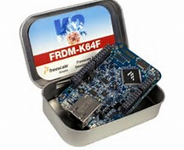
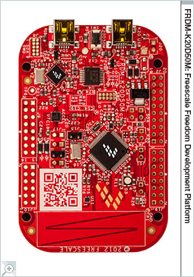

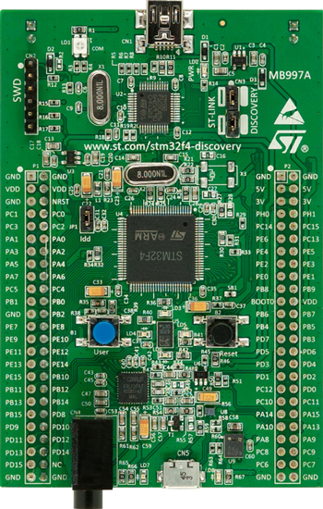
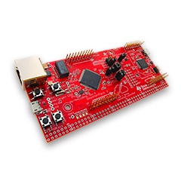
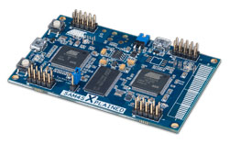
Low Cost Dev Boards
Freescale FRDM $($15-$60)
NXP LPCXpresso ($25-$40)
Atmel Xplained ($30-$40)
ST Discovery ($15 - $50)
TI Launch Pad ($15-$30)

Slide 28
Let’s Talk Bare Metal
Assembly language programming not required BUT…..
You should take a look at the instruction set
Some real gems in the manual….
You *need* to think about YOUR algorithm and how it will map.
You *need* to be familiar with your compiler and optimization levels.
You need to be familiar with the documentation
http://infocenter.arm.com/help/index.jsp

Slide 29
Some Interesting Instructions
Integer: UMLAL and SMLAL
Multiply, with optional Accumulate, using 32-bit operands and producing a 64-bit result.
http://infocenter.arm.com/help/topic/com.arm.doc.dui0553a/DUI0553A_cortex_m4_dgug.pdf
Using these we can have IIR filters with 64-bit precision in the accumulation / State Variables.

Slide 30
High Precision Filter Using SMLAL
Input
Good for filters where Fo << Fs.
Very low filter noise
I.E. IIR Audio BiQuad with Low Cutoff
x[n]
Z⁻¹
x[n-1]
Z⁻¹
x[n-2]
b[0]
X
b[1]
X
b[2]
X
Σ
Σ
Σ
Output Formatting
SMLAL
Σ
Σ
Output
a[2]
X
a[1]
X
y[n-2]
Z⁻¹
y[n-1]
Z⁻¹
Gray = 32-bit Green = 64-bit Purple = User Defined

Slide 31


Some Interesting Instructions
SMUAD and SMUSD
Signed Dual Multiply Add and Signed Dual Multiply Subtract
16-bit FFT Butterfly
Fast FIR,IIR → You can process multiple 16-bit taps at one time

Slide 32
Some Interesting Instructions
VLMA, VLMS ,VNMLA, VNMLS, VNMUL
Multiplies two floating-point values, and accumulates or subtracts the results . Floating-point multiply with negation followed by add or subtract.
For floating point filters. Note that with SMLAL we can get more precision with the integers!
Floating Point Note: Your toolchain may *not* have the FPU initialized in the C startup routines.

Slide 33
Do I need to write assembly code?
Sometimes it is useful. I have found the SSAT instruction useful in many cases.
Some of the instructions can be inferred in C code
acc += (q63_t) x2 * b2
Will compile to an SMLAL (with the right optimization levels!)
q63_t
q31_t

Slide 34
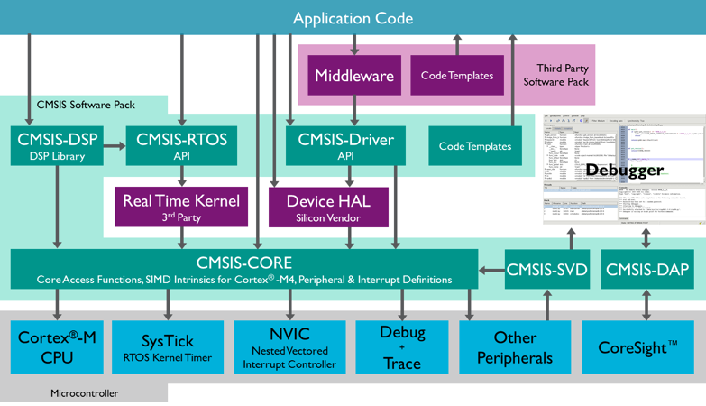
Cortex Microcontroller Software Interface Standard CMSIS

Slide 35
Kicking the CMSIS Tires
CMSIS Code can be acquired here:
http://www.arm.com/products/processors/cortex-m/cortex-microcontroller-software-interface-standard.php
Open source…. Easy to look at. Let’s look at the package

Slide 36
Some Library Fundamentals
Fixed Point Data types
Q0.7 Q0.15 Q0.31 Q0.63
Defined data types used a fixed point scaling normalized from -1 to 1
Some functions output other fixed point scalings (FFT)
*most* functions have a Q0.15 and Q0.31 version for data inputs. Some use internal resolutions at Q0.63 or Q1.62 for high precision
Documentation does a good job an indicating when you need to scale, saturation, etc.
Floating Point – 32-Bit IEEE 754. (Some M7’s will support doubles in future)

Slide 37
Filtering Functions
IIR, FIR, Interpolation, Decimation…..
Post shift to implement coefficients > 1
Pay attention to coefficients
Let’s look into the docs

Slide 38
Frequency Domain
Real & complex FFTs
DCT
Bit reversed ordering options
Let’s look in the documentation….. Lots to talk about…

Slide 39
Building the CMSIS Library
CMSIS includes Keil uVision build example projects.
You should learn how to build the library from scratch.
Lots of options –> optimization levels, compiler flags, etc.

Slide 40
Building the CMSIS Library
SoftABI
Single precision floating point operations are implemented in hardware and hence provide a large performance increase over code that uses traditional floating point library calls, but when calls are made between functions any floating point parameters are passed in ARM (integer) registers or on the stack.
SoftABI is the 'most compatible' as it allows code that is not built with hardware floating point usage enabled to be linked with code that is built using software floating point library calls.
http://www.support.code-red-tech.com/CodeRedWiki/CM4_FloatingPoint

Slide 41
Building the CMSIS Library
HardABI
Single precision floating point operations are implemented in hardware, and floating point registers are used when passing floating point parameters to functions.
HardABI will provide the highest absolute floating point performance, but is the 'least compatible' as it means that all of the code base for a project (including all library code) must be built for HardABI.
http://www.support.code-red-tech.com/CodeRedWiki/CM4_FloatingPoint

Slide 42
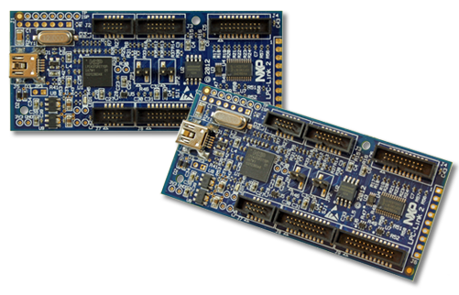
CMSIS Library Performance
LPC-LINK-2 as an evaluation board for NCP LPC4370 @204MHz – Triple Core (CortexM4 + 2 Cortex M0).
RAM only Device. Can get close to ideal performance
LPCXPRESSO4337 – eval board ($25) for LPC4337. Dual Core (Cortex M4F + Cortex M0). Flash based.
These are high end implementations of the M4. We can use them to develop scaling equations for RAM based and FLASH based execution
ADD NOTE ABOUT 54110 and Kinetis

Slide 43
CMSIS Library Performance – Test Methodology
We want to get a measure of “clock cycles” to execute code. (not time). We can use this to scale to other CPUs
LPC43xx Timer 0 can run at core rate. 32-bit
Reset Timer0, Start Timer0 → Stop Timer0→ Read Timer0 value
This is our “overhead” in clock cycles to measure function execution
Reset Timer0 →Start Timer 0->Execute DSP Code→Stop Timer 0 →Read Timer0 and subtract “overhead”
Between the RAM based and Flash based platforms, we should get some real world profiles.

Slide 44
CMSIS Library Performance – Test Methodology
Real and complex FFT at varying block sizes for Q15, Q31 and float.
IIR Filter – high precision Q0.31, Q0.15 and float
FIR Filter – high precision Q0.31 , Q0.15 and float
Eli’s per sample high precision Q0.31 BiQuad
Look at different optimization Levels (O0,O1,O2,O3,Og,Os) and SoftABI vs HardABI
Code available on GITHUB
https://github.com/ehughes/ESC-M4

Slide 45
CMSIS Library Performance – Test Methodology
Now for the results…. Let’s look at Eli’s spreadsheet!

Slide 46
Some Fun Applications/Demonstrations

Slide 47

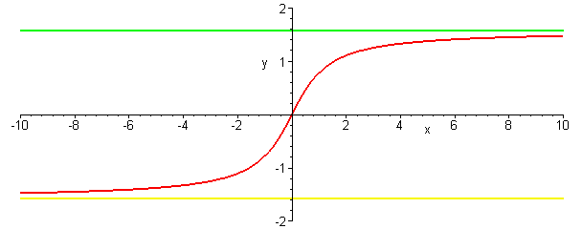
Some Fun Applications/Demonstrations
MonkeyJam
https://community.freescale.com/docs/DOC-100149

Slide 48

Some Fun Applications/Demonstrations
MonkeyListen
https://community.freescale.com/docs/DOC-100207

Slide 49
M4 to the M7
The Cortex M7 was recently release with a handful of vendor implementation.
M4 is limited by memory access (No Caches)
M7 has different pipeline, Cache and tightly coupled memory
M7 has a variant for double precision floating point
M7 is very new…. Some silicon implementations (ST, Atmel, Freescale). M4 has a lot selection. Come back next year!

Slide 50
Questions and Discussion

